Slide 1
Team Number: 16 Members: David Hernandez, dherna71 Juan Zambrano, jzambr7

Slide 2
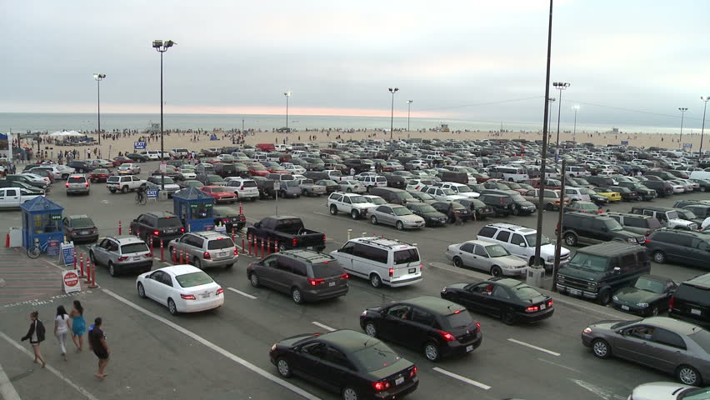
Parking Lot Vacancy
This project will display any free parking spaces in each lot. If one entire lot is taken the LCD will display some sort of indicator to go to the next lot. If there are any free spaces in the lot, the LCD will display the parking lot position. For example, the LCD would print “C is free” so no one must look around for the parking space. This project would simulate real world situations were parking lots are busy and you can spend a couple of minutes looking for space especially in populated areas or events. Finding parking space will be more efficient.

Slide 3
Parking Lot Vacancy Technical
This project uses laser trip wires to determine any spaces available. The laser is directly aimed at a specific photoresistor for each space. When photoresistors receives light from the photoresistors it reads values of 800+. So as soon as car blocks the laser the values from the photoresistor will fall dramatically and the code will determine it as space taken and only print spaces available.

Slide 4
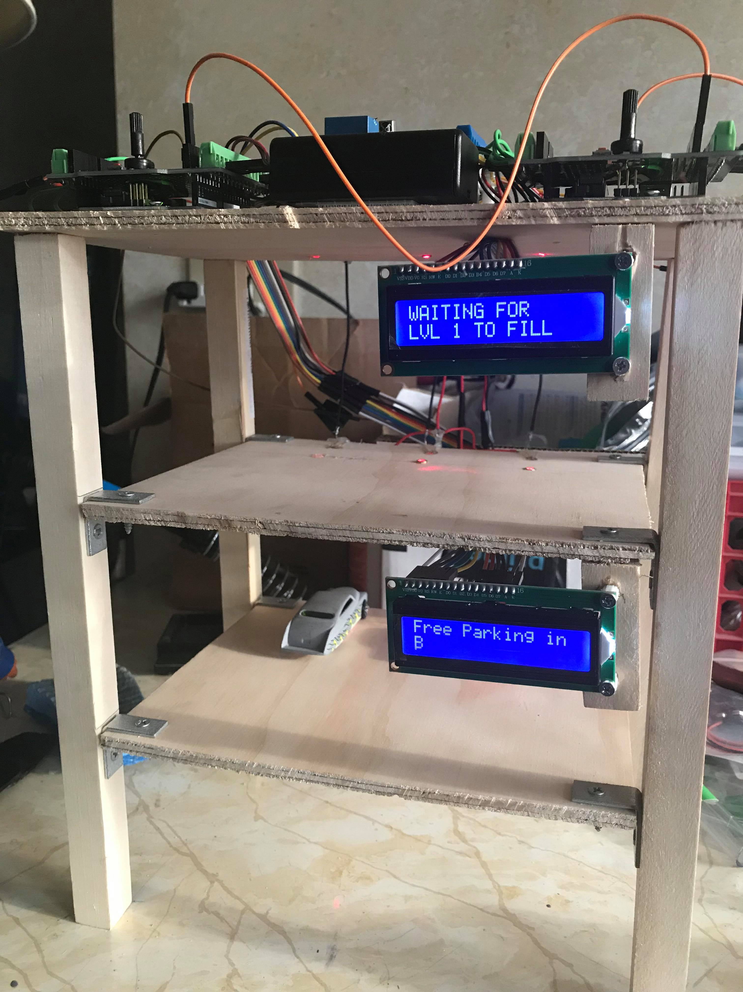
Original WOrk
Each lot will have three parking spaces with an LCD
Three laser trip wires each lot to detect any spaces available. When a car crosses the laser then space is taken.
Once all three spaces are taken in level one lot then level two let will display any free parking spaces. As soon as one space is free on level one lot, level two lot will not display any free spaces available.

Slide 5
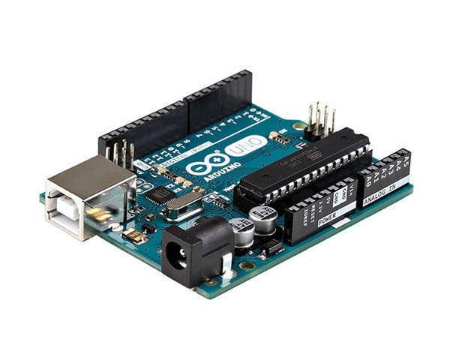
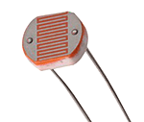
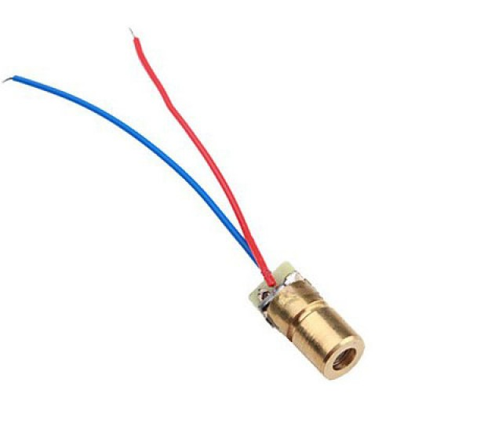
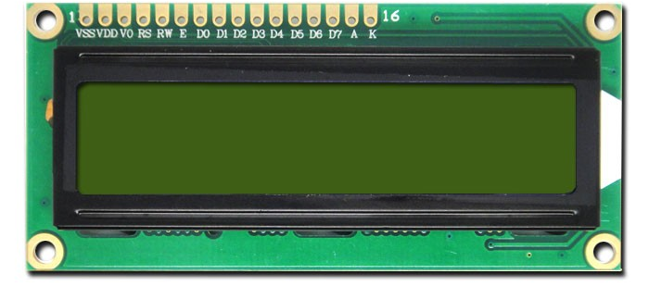
Devices Used
Input Devices:
Photoresistors x 6
Output Devices:
Lasers Diode x 6
LCD x 2
Input/Output Devices:
Arduino x 2

Slide 6
Communication
This project consist of using Serial Peripheral Interface (SPI) between the two Arduinos.
Each Arduino will handle one parking lot.
The Arduino on level one parking lot will send data to the level two Arduino. Depending on what level two Arduino receives the LCD will display specific information.

Slide 7
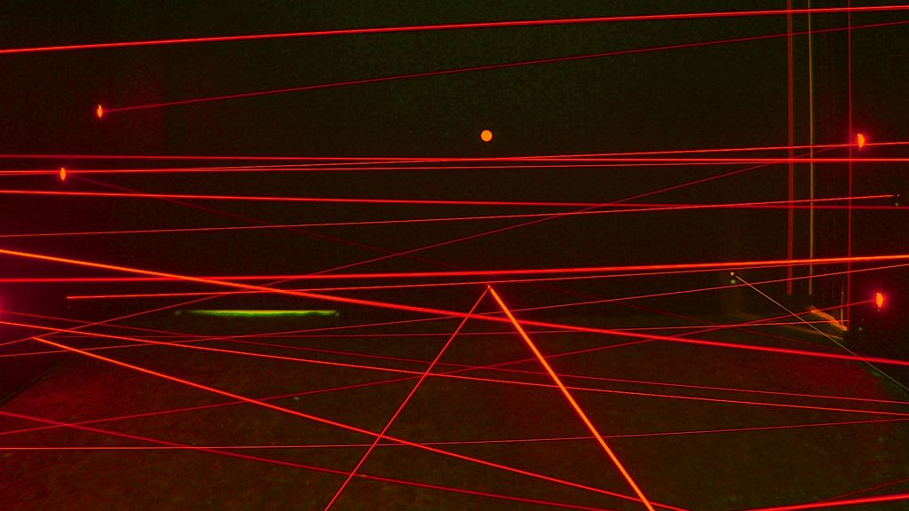
What Works
What Doesn’t
Laser Trip Wire to detect if any spaces available.
Consist of a laser aiming at a photoresistor.
Photoresistor reads values from 800+.
LEDs scatter light and is not precise.
Photoresistor may read light from a different parking space.
Also some LEDs may not be as bright as a laser. So ambient light may be brighter.

Slide 8
LIST OF MATERIALS
● 6 Lasers
● 6 Photoresistors
● Two Arduinos
● Two 16x2 LCDs
● 6 Toy Cars
● Wood for the platform
● Wires, Resistors, etc. (Electronical)
● Shield for both Arduinos

Slide 9
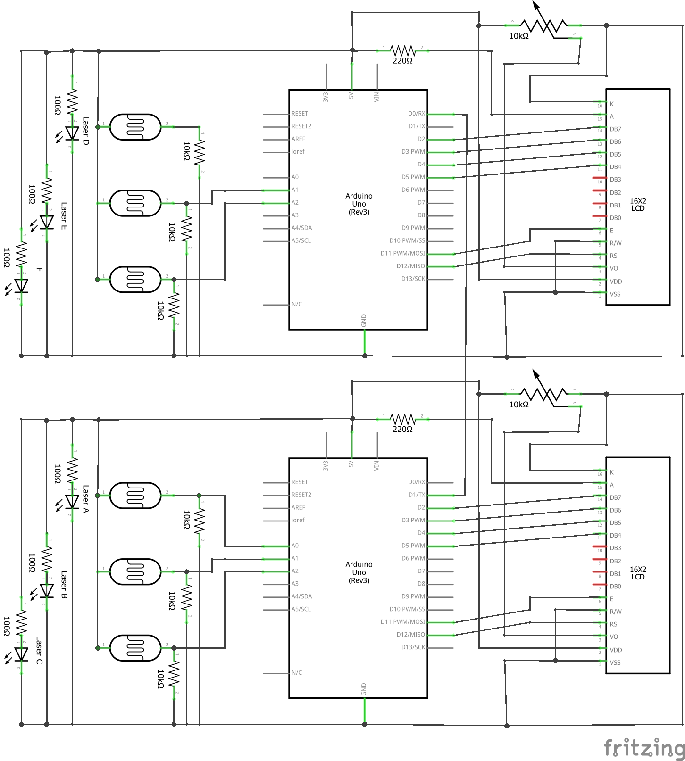
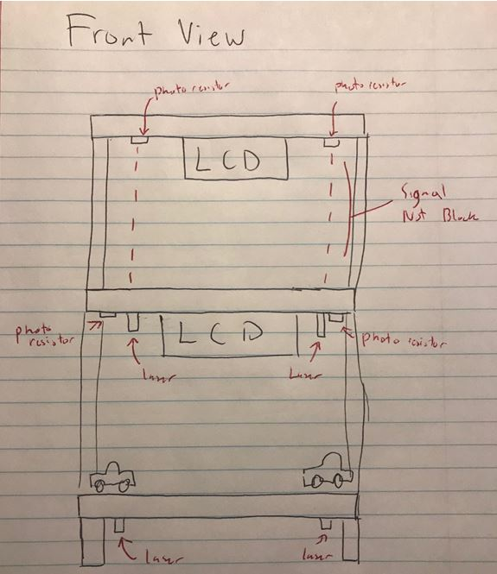
Basic Schematics
Design Drawing

Slide 10
Timeline
Week 1 – Learn how to communicate between two Arduino ​(Done)
Week 2 – Code for one parking lot ​(Done)
Week 3 – Test trip wire with one car ​(Done)
Week 4 – Implement LCD ​(Done)
Week 5 – Code for second parking lot ​(Done)
Week 6 – Communicate both Arduinos via serial with new code ​(Done)
Week 7 – Build two level platform parking lot and test for any bugs ​(Done)
Week 8 - Implement a separate PCB that powers both Arduinos, lasers, LCD, and photoresistors (Done)
Week 9 – Clean wiring (NOT DONE)

Slide 11
References
https://www.youtube.com/watch?v=BNfGoy5dqbg
http://playground.arduino.cc/Learning/PhotoResistor
https://www.arduino.cc/en/Tutorial/LiquidCrystalScroll
Code
https://github.com/jzambr7/ParkingVacancy_362

Slide 12
TEAM ROLES
David & Juan:
Electrical
Hardware
Code
Building the base

